Slide 1
Notes:
Theme of 2015 Viva World Weekend of Prayer ‘I am with you always’ (Matthew 28:20)

Slide 2
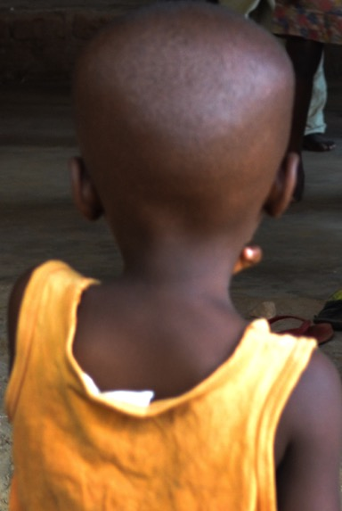
Children do not always know this. When you see the world in the eyes of a vulnerable child it can be painful, frightening and lonely.

Slide 3
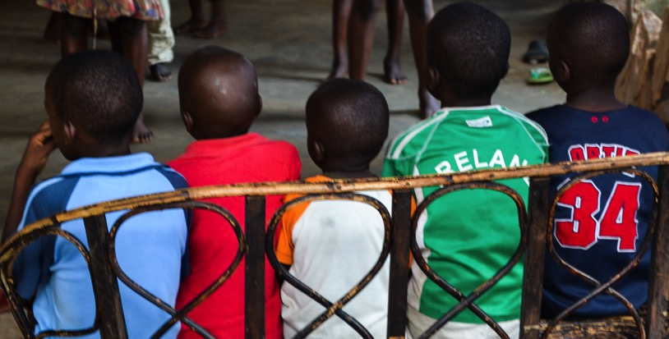
One billion children worldwide live in poverty, with:
6.6 million under-five year-olds dying from preventable causes
One in ten girls married before they reach 15 years old

Slide 4
we believe that God brings
protection, provision and promises.
on behalf of children at risk, that God will give them strength and protection

Slide 5
God protects
‘Even though I walk through the darkest valley, I will fear no evil, for you are with me; your rod and staff, they comfort me.’
Psalm 23:4
God provides
‘My God will meet all your needs according to the riches of his glory in Christ Jesus.’
Philippians 4:19
God promises
“‘For I know the plans I have for you,’ declares the Lord, ‘plans to prosper you and not to harm you, plans to give you hope and a future.’”
Jeremiah 29:11

Slide 6
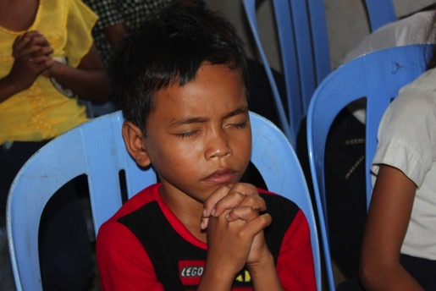
A Viva Children’s Prayer Movement programme in Cambodia focuses on the power of prayer for children. It aims to make pastors and children’s workers more aware of child spirituality.
Ngong Kim from Cambodia, has a simple faith. “May God bring my parents back together so that I can live with them as a family. By God’s grace, everything in my life will be taken care of by faith.”

Slide 7
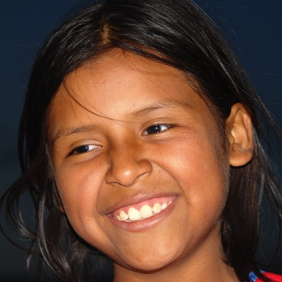
For every child, wherever they are, to feel the presence of God in their lives, knowing he is with them always.
That children who are afraid would know God’s protection. May they feel safe in his loving arms and turn to him in all circumstances.
That children in need would trust in God’s provision. May he ease their anxieties and, by his power, supply them with life’s essentials.

Slide 8
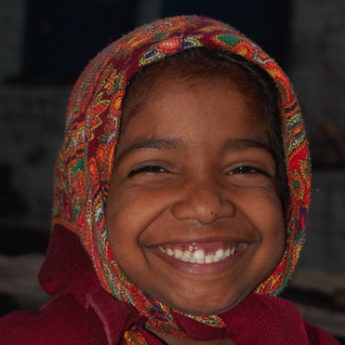
That children who feel insecure would remember God’s promises. May they feel encouraged and empowered, and trust in his faithfulness.
That we as parents, caregivers and role models would keep the children around us safe and well, and help them to fulfil their God-given potential.

Slide 9
Father God
We thank you God for your faithful promises, and that you protect us and provide for us. Thank you for your strength when we are weak, for your unconditional love when we despair and for your hope when times are hard.
We pray that children who are vulnerable and marginalised would know more of your powerful presence in lives that are often marked by pain, fear and loneliness. May the words of your son, Jesus, ‘I am with you always’, be a reality for them today.

Slide 10
We pray that, through the power of your Holy Spirit, we would be your hands and feet, showing love in action, shaping communities of joy and hope, and committed to inspiring lasting change in children’s lives.
In your name we ask this. Amen.

Slide 11
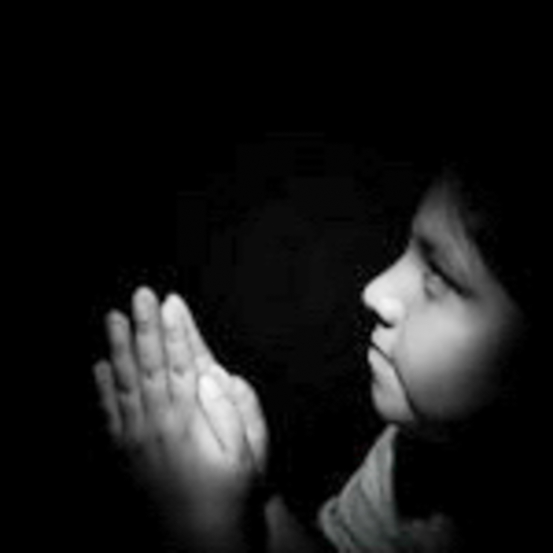
Can you think of one child, especially isolated, afraid, insecure or anxious at this time?
Will you commit to pray for them over the Viva Weekend of Prayer?
Can you help them know God’s words, “I will be with you always”?

Slide 12
The World Weekend of Prayer campaign is a global initiative held over the first weekend of June every year, uniting hundreds of thousands of adults and children across more than 40 countries.
Viva is an international Christian charity that is inspiring lasting change in children’s lives through the power of collective action in 34 community networks worldwide.

